Slide 2
https://github.com/GoogleCloudPlatform/cloud-run-samples/blob/main/README.md

Slide 3
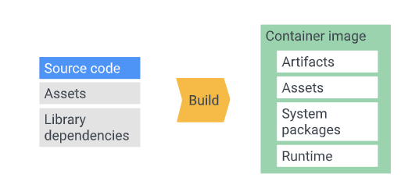
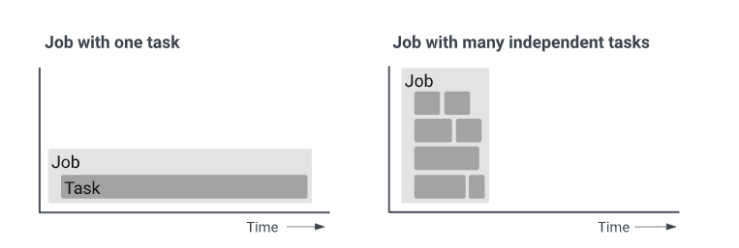
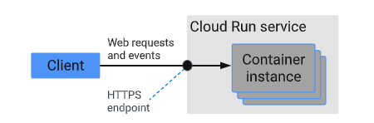
Cloud Run
Deploy code (Go, Node.js, Python, Java, .NET):
Should be build in Container images
Scale to zero and minimum instances:
[Scale to Zero] If no incomming request, last remaining instance will be removed. This one can be configed
No instance >> when a incomming request >> new instance will be created (may be take longtime to resposne)
Pay-per-use pricing for services
Use cases
Cloud Services
Cloud Run Jobs
Notes:
https://cloud.google.com/run/docs/overview/what-is-cloud-run
https://cloud.google.com/run/docs/quickstarts/deploy-container
https://github.com/GoogleCloudPlatform/cloud-run-microservice-template-python

Slide 4
Deployment (Backend - Python)
Deploy on local machine
Packge in Flask
WSGI HTTP Server
gunicorn
Werkzeug
Pure Python Source + Cloud Service Lib
Setup ADC
(API Key example)
http request
Packed all artificals
Flask (route, handle request/response) to expose APIs
Deploy on Docker
Dockerfile
docker-compose.yml
Docker image
(build steps in Dockerfile)
Instance
Docker Container
(define services in docker-compose.yml)
http request
Deploy on Cloud Run (using Docker)
Dockerfile
Artifact Registry Repository (created)
Docker image with tag Artifact Registry URL
docker push
Docker image with tag Artifact Registry URL
http request
Example of Artifical Registry URL:
<REGION>-docker.pkg.dev/<PROJECT-ID>/<REPOSITORY>/<IMAGE:TAG>
asia-east1-docker.pkg.dev/hohai-sample-cloud-run/translation-backend/translation-backend:tag1

Slide 5
Docker Deployment (Frontend - ReactJS)
Volumes mount
Artifacts
Dockerfile.dev
Dockerfile.prod
Docker container
node image + required modules
node:14-alpine
node:14-alpine
Mounted Volumes
http request:3000
{package.json}
COPY
node base Image
Base Image
Vite (dev server)
Dev dependencies
Vite (dev server)
Dependencies
(Dev & Production…)
RUN npm install
RUN npm install
Base Image:required modules
Base Image: required modules
Host port = 3000
COPY
Base Image: required modules + SC
Base Image: required modules + SC
Docker container
Source code + assets
build (by Vite buid or React Script build)
nginx server: built app
EXPOSE 5173
http request:8080
CMD (Vite Dev)
Base Image: built source
Vite Dev Available to Run
COPY –from…
nginx-alpine
Host port = 8080
Container port (exposed) = 5173
Server image
Dev docker-compose
Server image: build source
EXPOSE 80
CMD nginx
nginx.conf
nginx server available
Container port (exposed) = 80
Notes:
https://viralganatra.com/docker-nodejs-production-secure-best-practices/
https://cloud.google.com/run/docs/internet-proxy-nginx-sidecar

Slide 6
Developing service
Service must listen for requests (PORT environment variable)
Service must stateless
>> Using a web server (example Flask for Python)
Notes:
https://cloud.google.com/run/docs/developing
https://cloud.google.com/run/docs/quickstarts#build-and-deploy-a-web-service
https://github.com/GoogleCloudPlatform/cloud-run-samples/blob/main/README.md
https://github.com/GoogleCloudPlatform/python-docs-samples/blob/main/run/helloworld/e2e_test.py

Slide 7
Containerize code
To deploy to Cloud Run, need a container image (packaging code, dependencies,…)
Create a container image:
Using Dockerfile
Using Buidpacks:
https://cloud.google.com/docs/buildpacks/builders

Slide 8
Buidling Containers >> Using Dockerfile
Building using Cloud Build:
https://cloud.google.com/run/docs/building/containers
Navigate to the folder containing your sources and Dockerfile.
gcloud builds submit --tag IMAGE_URL
Buidling locally using Docker:
Navigate to the folder containing your sources and Dockerfile
docker build . --tag IMAGE_URL
If not configured Docker to use Google CLI (to authenticate request to Container Registry), then:
gcloud auth configure-docker
Push the container image to container registry
docker push IMAGE_URL

Slide 9
Buidling Containers >> Using Google Cloud’s Buildpacks
Navigate to the folder containing your sources.
gcloud builds submit --pack image=IMAGE_URL

Slide 10
Test Locally
https://cloud.google.com/run/docs/testing/local#docker
Notes:
https://cloud.google.com/run/docs/developing
https://cloud.google.com/run/docs/quickstarts#build-and-deploy-a-web-service

